Slide 1
V.I.R.U.S (Viral Infection Response Unit Strategists)
BY RYAN MANNING, HARRY STATHAM, KIERAN BOYCE, LIAM DAVID
Notes:
harry

Slide 2

Games inspiration- Viruses
Coronavirus – A current event affecting everyone, universal theme and relativity, perhaps one of the most influential times of our lives that will create ramifications for years to come
Other Viruses – Though the most prominent event in our lifetimes this theme will never become irrelevant:
Swine Flu
Norovirus
Many more, viruses adapt as we do
Though perhaps not as extreme as current events medical
events like this will always be a prominent and invisible threat
to humanity, educating on appropriate responses is essential
Notes:
kieran

Slide 3
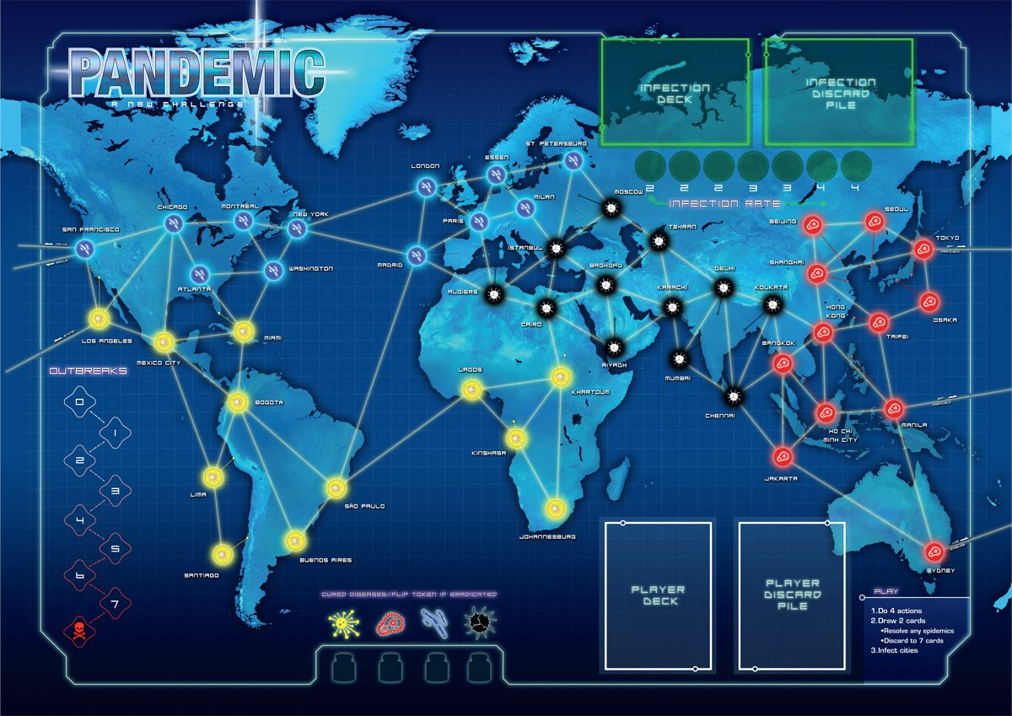
Games we researched (Pandemic)
Pandemic – The link is obvious; this theme is not an unusual one
Good at expressing the global impact
Though the mechanics of the virus are abstracted from reality, the context is literal and is an effective link to reality
Though our focus is on the response methods as opposed to the global impact we did take the following ideas of Pandemic:
Focus on co-operative play
The idea of an evolving virus that can quickly become overbearing if not contained
Notes:
ryan

Slide 4
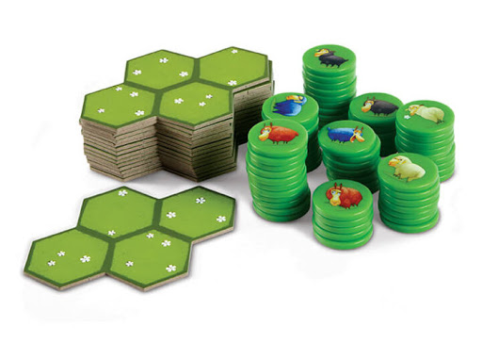
Games we researched (Battle Sheep)
The most interesting aspect of this game for us is the way the board is crafted
Through a series of modular pieces the players take turns to place the pieces to build their own board at the start of the game
This keeps the game fresh every time, by combining random elements with a new board layout every time you create a fluid gameplay experience
Replayability is at the forefront of this idea
A misunderstanding of rules on initial playthrough lead to the idea of “containing” areas of the board which translated into containing a virus, leading to the development of our theme
Notes:
liam

Slide 5
Games we researched (various card games)
After some debating on the main method of progression in the game we decided on using a card-based “mana” system
The most difficult aspect of this is balancing the cards themselves, with the cost of using it
Luckily members of the team had experience in these kinds of card games e.g.
Slay the Spire
Hearthstone
Using the experience we already had we were in a good position to get a feel for balance
Notes:
ryan

Slide 6
Iteration
The various iterations of our game are easiest represented through 4 ‘milestones’:
Version 1 – Battle Sheep modular board, no cards but similar movement to original Battle Sheep, all controlled by player
Version 2 – Cards are added, with dice-colour based movement to follow shortly
Version 3 – Endgame iterated upon, dragged out gameplay and became tiresome
Version 4 – Cards balanced through testing
Notes:
harry

Slide 7
Box Contents (for if we had a physical copy)
20 x board pieces
2 x Player pieces (for each player)
4 x Player Base pieces
30 x Virus pieces
44 x Player cards (for each player)
67 x Virus cards
3 x Energy Counters(for each player)
4 x Base pieces
1 x Rulebook
1 x Coloured die
5 x Research counters (for each player)
Notes:
Kieran

Slide 8
The Game
A 4 vs The Board Card Based Board Game
Each player is given 5 board pieces to build the board
The design of the board can influence a variety of factors that can come to affect overall difficulty of the game
Not only this but the players can decide to destroy between 3 and 5 virus pieces to win (again influencing difficulty and game length)
The player places their base piece on the side closest to them while the virus is placed as close to the center of the board as possible
Notes:
harry

Slide 9
The Game (Continued)
The virus begins the game by making three moves (drawing 3 cards)
Then all players make their moves by drawing 6 cards from their deck and playing them (topping up at the end of their turn)
After round one the virus will make two moves from this point on
This forms the main loop of the game
Notes:
harry

Slide 10
The Game (win/loss conditions)
Win:
Survive a luck roll – this is an unreliable method of winning, should all virus pieces on the board be eliminated, if the players can roll a yellow in 2/3 rolls the virus will not reappear and the game is over, otherwise the virus will make a move from the most recent players base
Research – Should a player eliminate a virus piece they are granted a research token, once all players reach their research token goals (decided by the players at the start of the game) the vaccine is created and the game is won
Lose:
No more moves – Should a players deck empty and they do not yet have all research tokens then the game is over as the vaccine cannot be created
Uncontrollable Infection – Should there be 12 virus pieces on the board at any one time the infection has become too prominent and the game ends
Notes:
Ryan

Slide 11
‘Blurb’
A Co-Operative game designed for 4 Players
Team up to fight the virus before the infection becomes too strong!
Timeless, Universal theme on what can be a misunderstood/underestimated invisible threat
A fun, strategic game with the benefits of educating on the benefits of viral response
Notes:
liam

